Slide 1

Hands-on III
Jonathan Muñoz (Co)
Guillermo Valiño (Uy)
Rodrigo Yarzábal (Uy)
Camila González (Ch)
Professors:
Leonel Gómez
Cecilia Herbert
Marcos Coletti
Juan Ignacio Sanguinetti
Latin American Training Program 2022, Montevideo, Uruguay

Slide 2

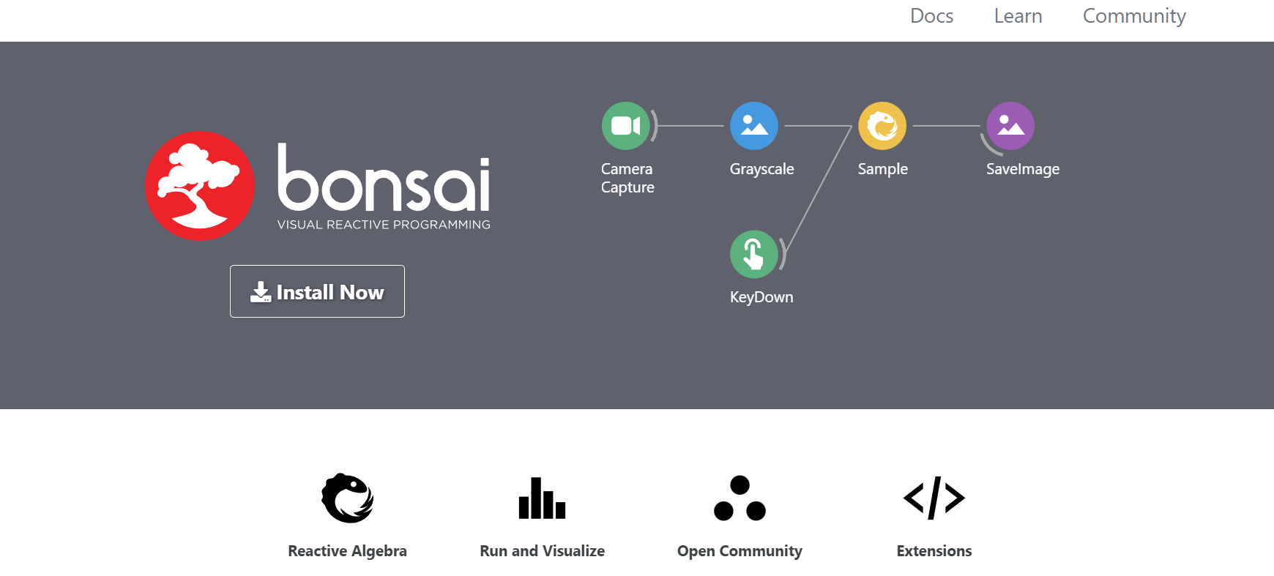
Bonsai as a powerful tool to study behavior
Open software
Visual Programming Language
Machine Vision
Closed loop
https://bonsai-rx.org/

Slide 3
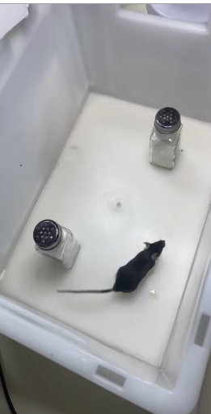
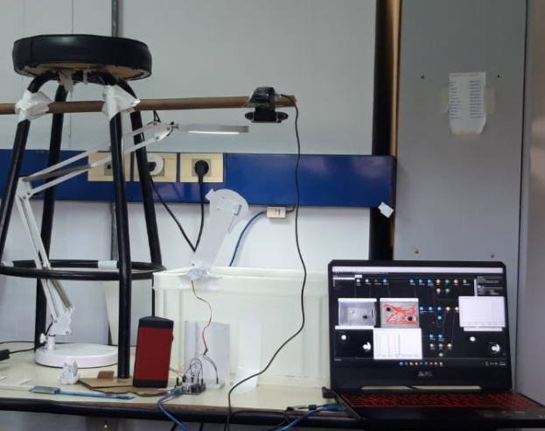
Closed-loop

Slide 4
Behavioral task: novel object recognition… with a twist!
New
Is it good? Or is it bad?
- I don’t know… But I need to choose a behavior
But, what happens if we interfere with the new object?

Slide 5
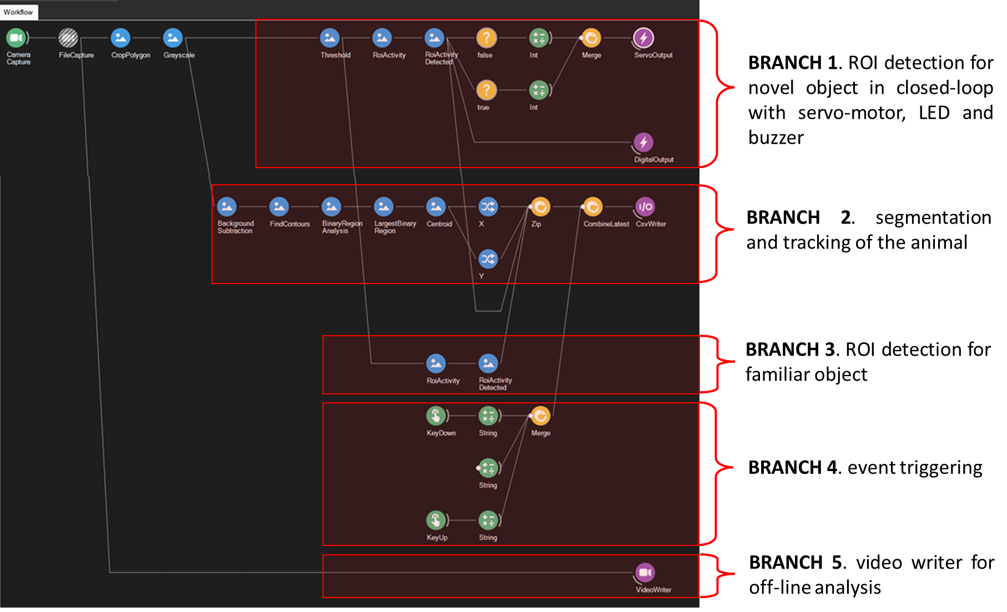
Workflow

Slide 6
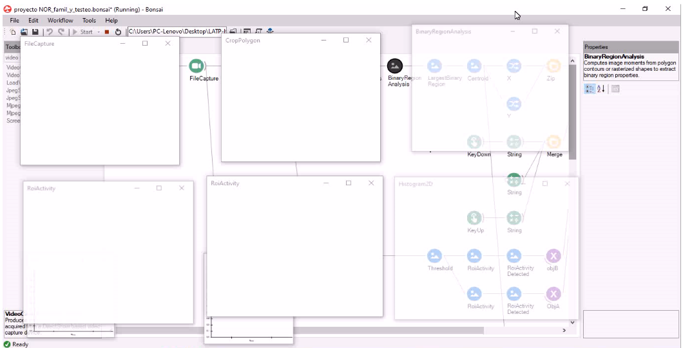

Slide 7
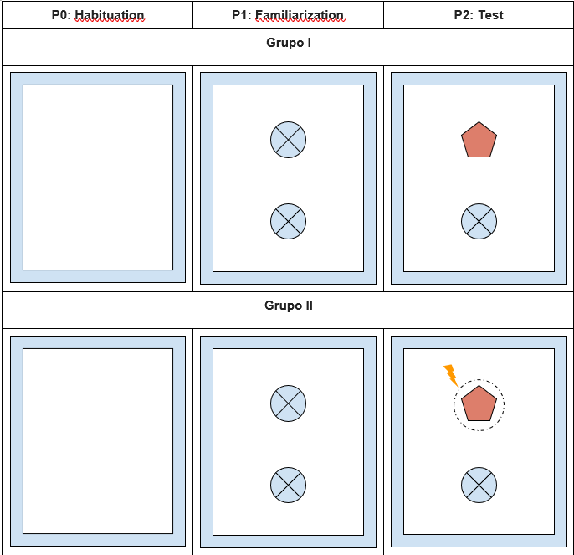
Experiment design
P0: 5min
P0 - P1 15 min
P1: 10min
P1 - P2 60min
P2: 10min

Slide 8
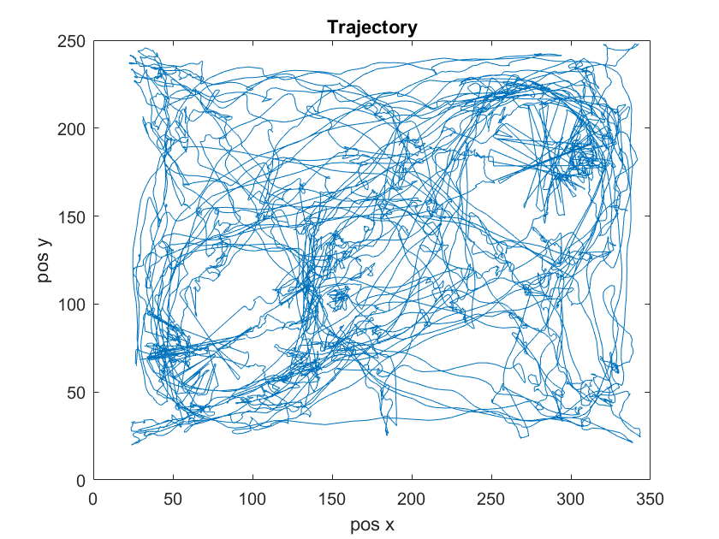
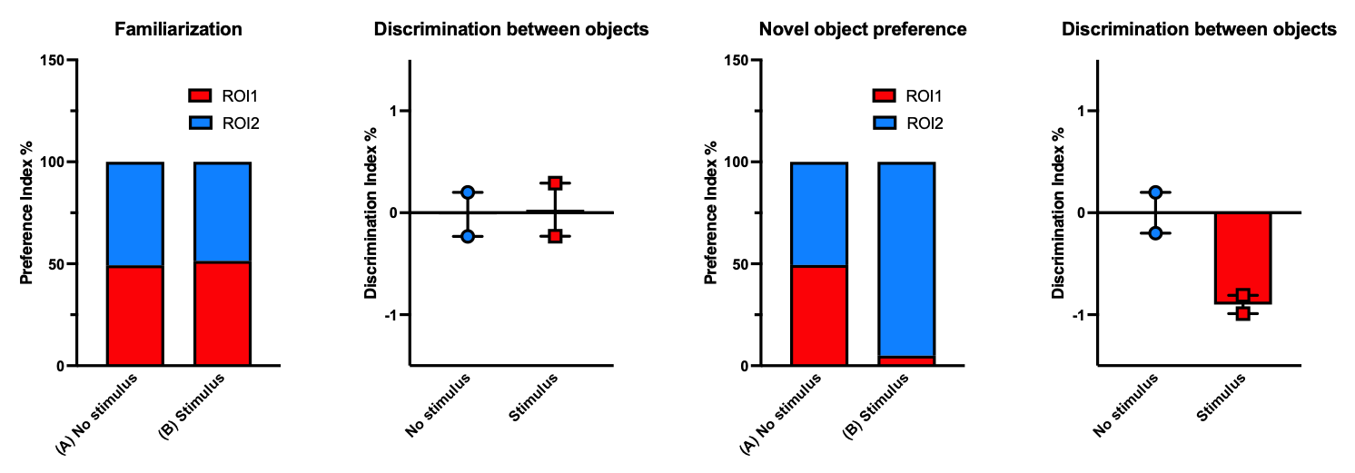
Results

Slide 9
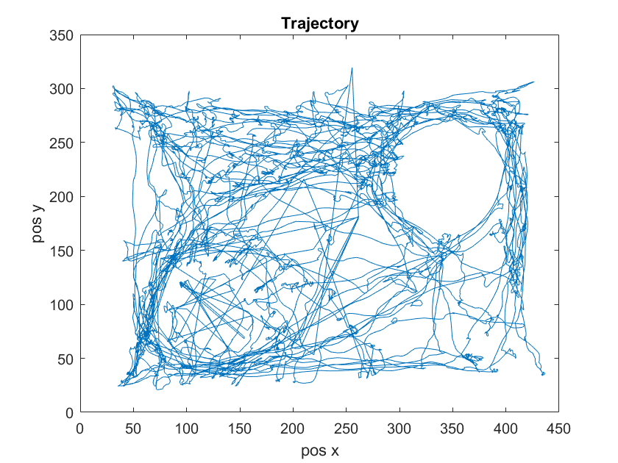
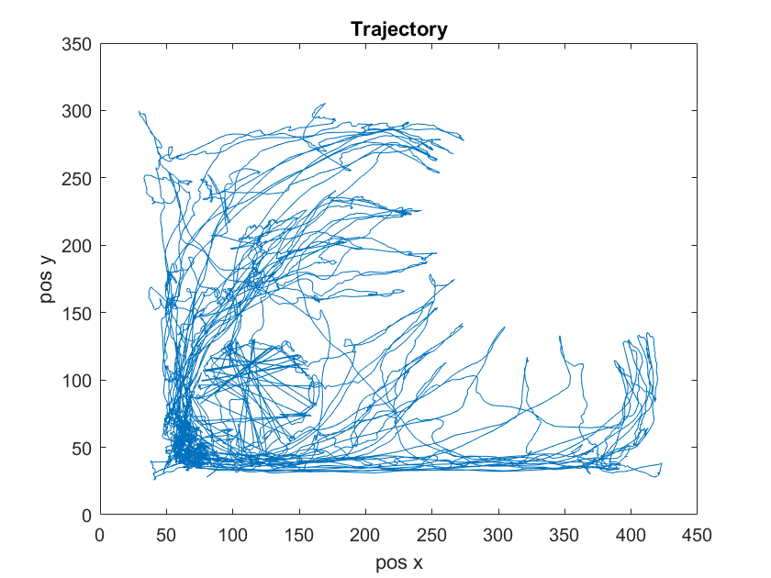
Results

Slide 10
Conclusion
Bonsai is a great tool for the experimental design and for data acquisition
https://bonsai-rx.org/ … our advise: download it!

Slide 11
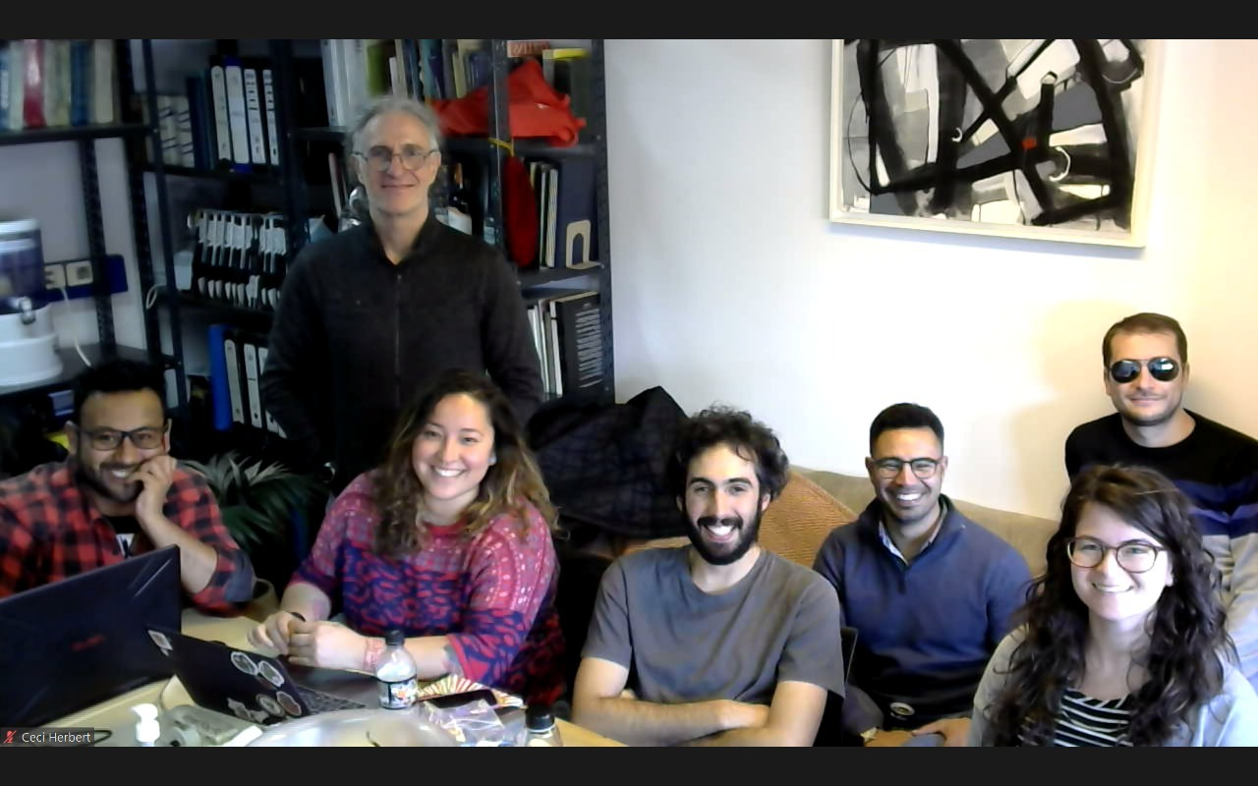
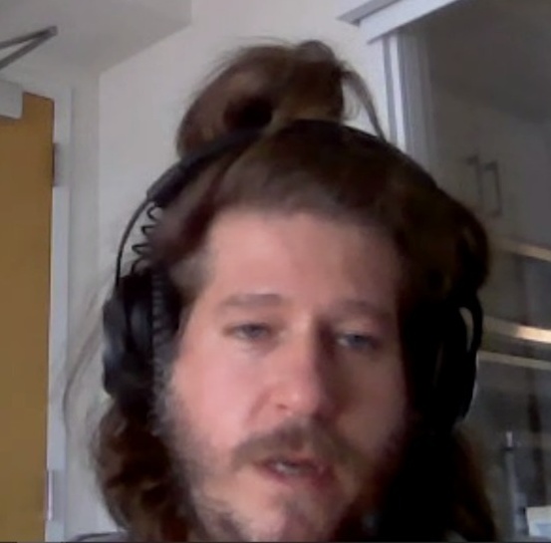
Thanks everyone!

Slide 12
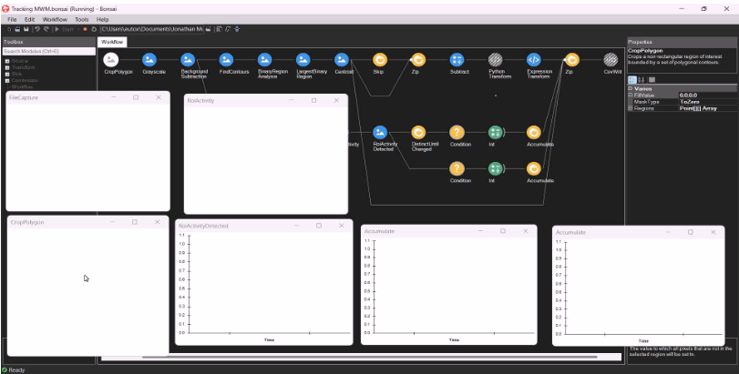
Implementation of Bonsai in other paradigm
Morris Water Maze (MWM)

